Slide 1
Foul Language Detection
Presented By:
Pratik Patil - 202118023
Bhavya Chandrasala - 202118028
Jeffrey James - 202118031
Tanya Jagyasi - 202118039

Slide 2

Introduction:
As we can see, the usage of offensive language increases day by day on social platforms, and in today's world, people want freedom, and social media gives people a platform to freely communicate, share opinions, and entertainment.
Along with all these benefits, it likewise opened doors for brutal conversations that can undoubtedly arrive at toxic levels.

Slide 3
Motivation:
First of all, what is Foul Language?
The Anger and frustration that can be dealt by using expressions or alternative methods such as usage of abusive words in comments which make them mean, telling offensive jokes, cursing using abusive words, etc.
With increase in culture of social media, usage of abusive language increases rapidly. Platforms like Facebook and Twitter have raised concerns about emerging dubious activity such as the intensity of hate or abusive behaviour among us.
All these things motivated us to solve this problem, and propose an approach in this report to automatically classifying tweets into two categories: Foul Language and Not Foul Language.

Slide 4
Dataset:
We applied some models and tested our proposed method using data from popular social media network: Twitter
We have also performed some cleaning, pre-processing, and visualization of this data.
Collection
Cleaning
Pre-Processing

Slide 5
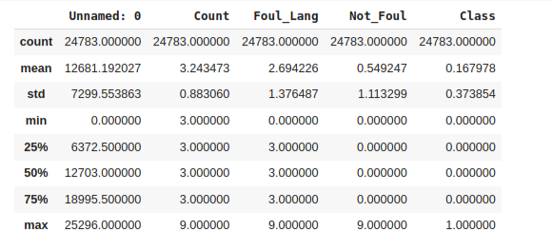
Data Collection:
We collect data from Kaggle to build models in this project,
and further used it for training and testing records.

Slide 6
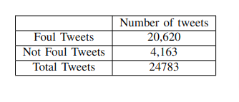
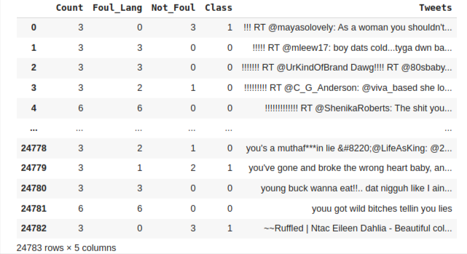
Data Cleaning:
The dataset is in a CSV format.
The attribute in the dataset named ‘serial number’ was of no use, and hence the column was removed.

Slide 7
Data Pre-Processing:
Using different libraries such as pandas, numpy, sklearn, nltk and expressions like regex, we have done some operations such as,
Tokenization
Removal of Punctuation, capitalization and numeric value
Removal of Stopwords
TF-IDF
Stemming

Slide 8

Evaluation Strategy:
Classification methods are generally evaluated using several evaluation matrices, depends on the confusion matrix. Those evaluation criteria are: Accuracy, Precision, Recall and F-Score..
They are calculated using to the following equations:
Accuracy = $\frac{TP+TN}{TP+TN+FP+FN }$ Precision = $\frac{TP}{TP + FP}$
Recall = $\frac{TP}{TP+FN}$ F-Score = $\frac{2∗Precision∗Recall}{Precision + Recall}$
Where,
TP – number of True Positive classes TN - number of True Negatives classes
FP - number of False Positives classes FN - number of False Negatives classes

Slide 9

Models Used:
We classify four models to check the precision, recall, and accuracy of our data, and based on those results; we got to know which model is best to classify our data.
Our Models are:
Logistic Regression
Decision Tree
Random Forest
Support Vector Machine

Slide 10
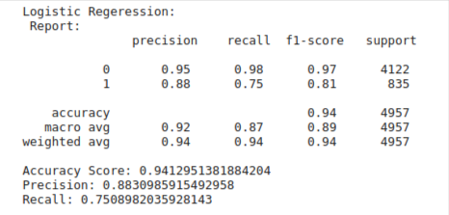
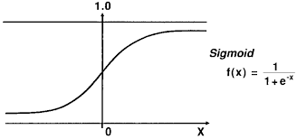
Logistic Regression:
The most frequent binary outcome in logistic regression models is something that can take two values, such as true/false, yes/no, and in the case of this project, foul/not foul. It assures that the output probabilities add up to one and stay between zero and one, as we would predict.

Slide 11
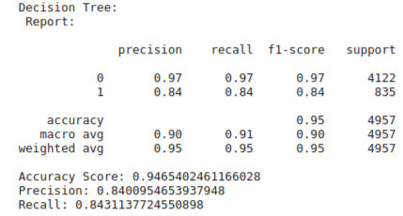

Decision Tree:
Decision Tree is a Supervised Learning algorithm.
It has decision node and leaf node.

Slide 12
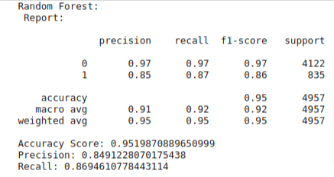
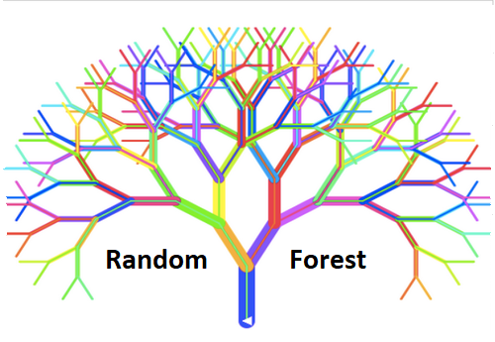
Random Forest:
A random forest is a machine learning approach for classifying and predicting outcomes. A method for resolving complex problems by merging many classifiers. Many decision trees make up a random forest algorithm.

Slide 13
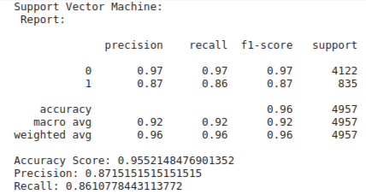
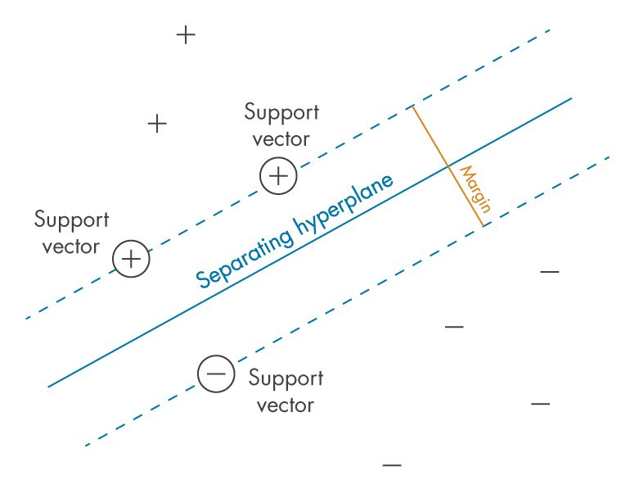
Support Vector Machine:
The Support Vector Machine is a Supervised Learning tool
The SVM method’s purpose is to find the hyperplane for classifying n-dimensional space
The distance between the closest point of the data point to the hyperplane is called the margin.

Slide 14
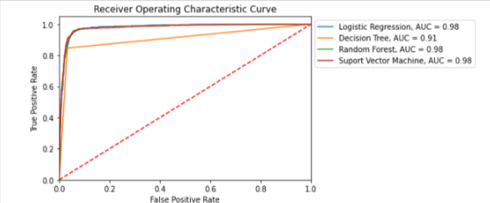
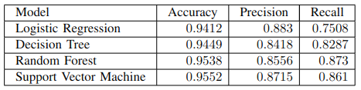
Results:
We have compared the accuracy, precision and recall of all the models and also plot the ROC Curves. Which clearly shows that the results of SVM are much better than all other models.

Slide 15
Conclusion:
From all the data that we have collected, analyzed and classified we conclude that for this data, as the high-dimensional feature space data points can be categorized even when the data is not linearly separable, SVM serves this purpose in the best way.
So, by comparing the accuracy scores we can say that Support Vector Machine is the best classification algorithm for problems like Foul Language detection.

Slide 16
Thank You!

